Slide 1

WELCOME

Slide 2
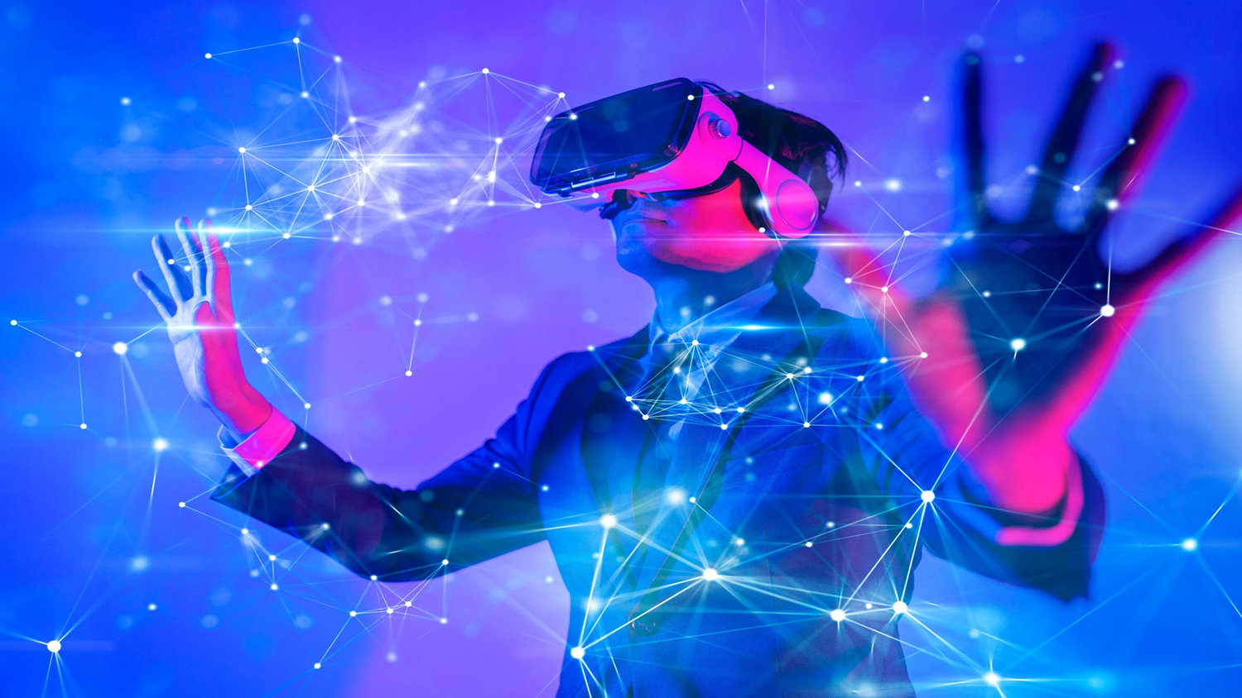

M.Sc(Cs) SEM-1 2021-2022
METAVERSE
PRESENTATION BY
KUNAL JEJURKAR
SAGAR BANSODE
SHUBHAM KHIRSAGAR

Slide 3
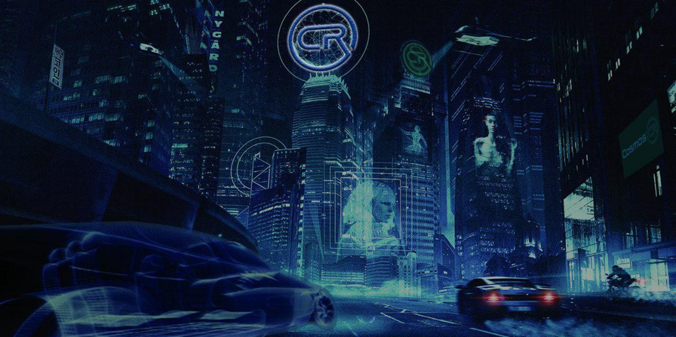
INTRODUCTION
THE TERM METAVERSE HAS ITS ORIGIN IN THE 1992 SCIENCE FICTION NOVEL SNOW CRASH AS A PORTMANTEAU OF “META” AND “UNIVERSE”.
A METAVERSE IS A NETWORK OF 3D VIRTUAL WORLDS FOCUSED ON SOCIAL CONNECTIONS.
IT’S A COMBINATION OF MULTIPLE ELEMENTS OF TECHNOLOGY, INCLUDING VIRTUAL REALITY, AUGMENTED REALITY AND VIDEO WHERE USERS “LIVE” WITHIN A DIGITAL UNIVERSE.

Slide 4
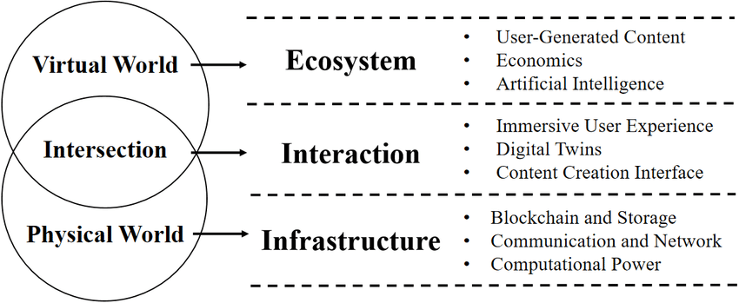
ARCHITECURE OF METAVERSE

Slide 5
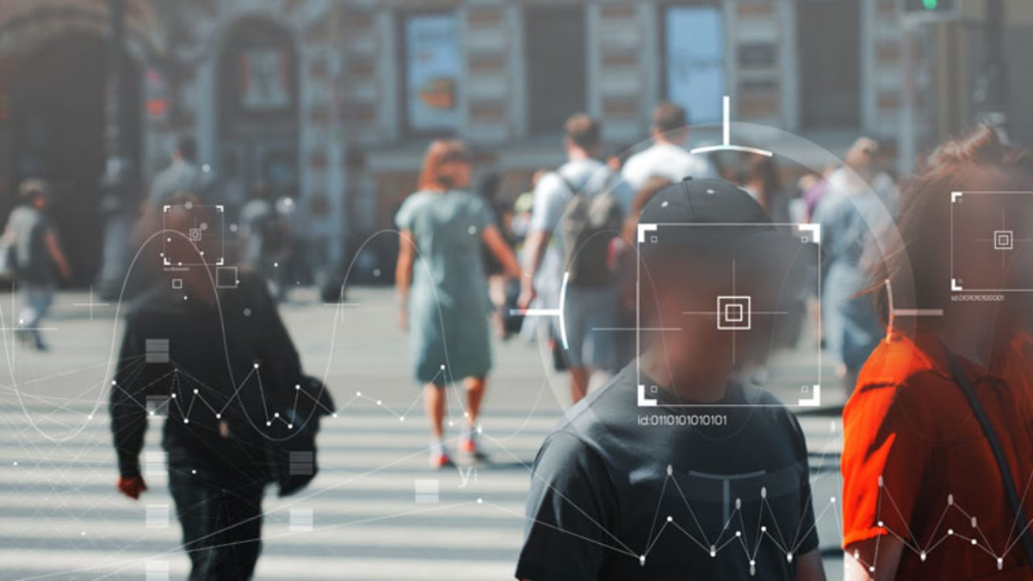
Computer vision techniques
IMAGE CLASSIFICATION
classifying pixel and vector groups in an image by applying specific rules is called image classification.
OBJECT DETECTION
object detection is a method used to identify and locate specific object in any image or video.
OBJECT TRACKING
object tracking is defined as tracking a moving object in any or many scenes.

Slide 6
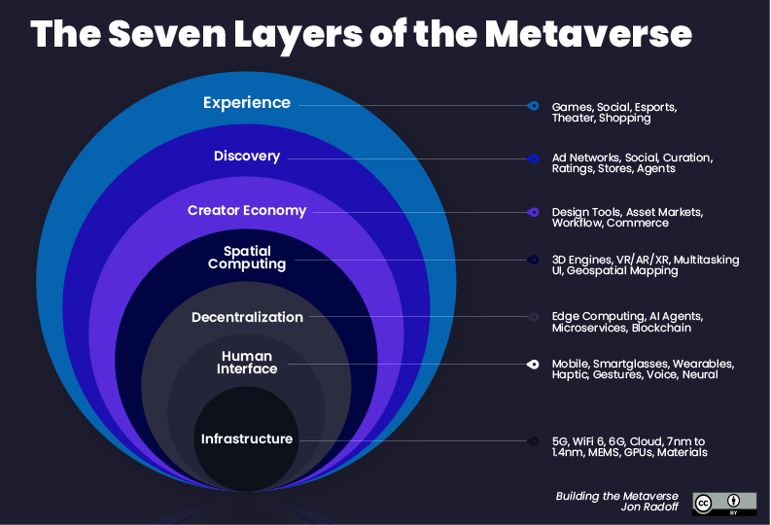

Slide 7

ADVANTAGES
Expansion of Social Media Beyond Web 2.0
Innovative Communication for Work and Education
New Opportunities for Businesses and Marketers
Complementing the Applications of Blockchain Technology
Creating and Further Promotion of a Virtual Economy

Slide 8
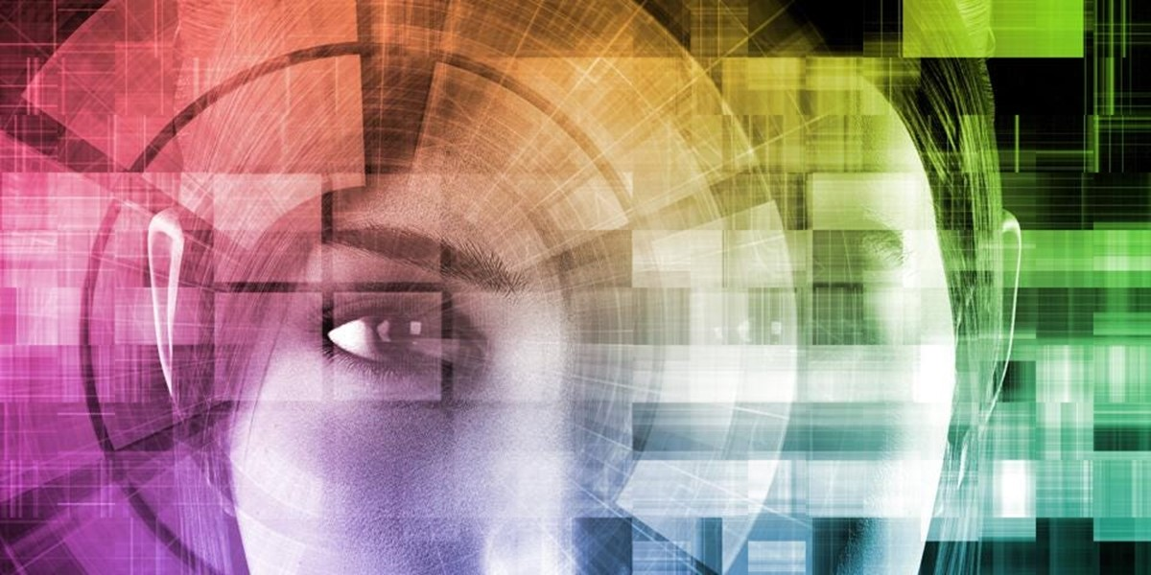
DISADVANTAGES:
REQUIRED ACCESSIBLE ADVANCED DIGITAL TECHNOLOGIES.
MAY ERODE HUMAN RELATIONSHIP AND SOCIETY.
PREVAILING AND UPCOMING PRIVACY AND SECURITY ISSUES.

Slide 9





TOP COMPANIES BUILIDING METAVERSE

Slide 10
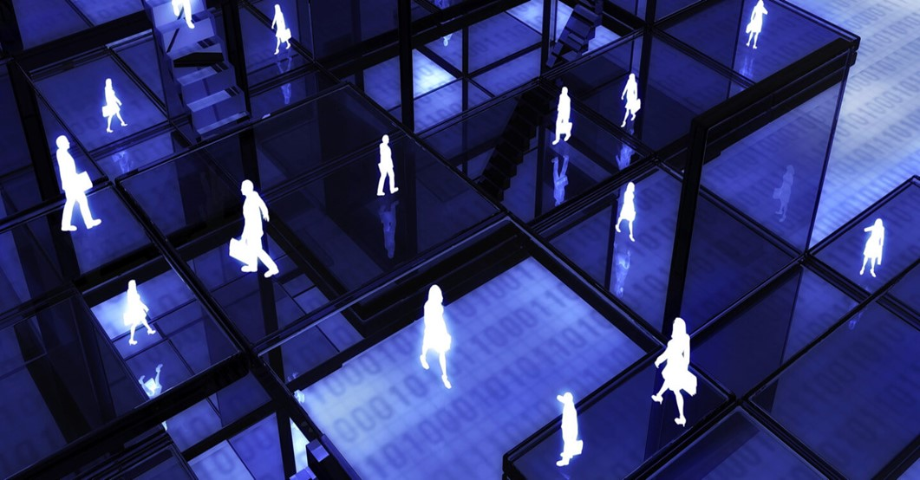
APPLICATIONS
METAVERSE REAL ESTATE APPLICATIONS
METAVERSE PRODUCTION APLLICATIONS
METAVERSE EDUCATION APLLICATIONS
METAVERSE REATIL APPLICATIONS

Slide 11
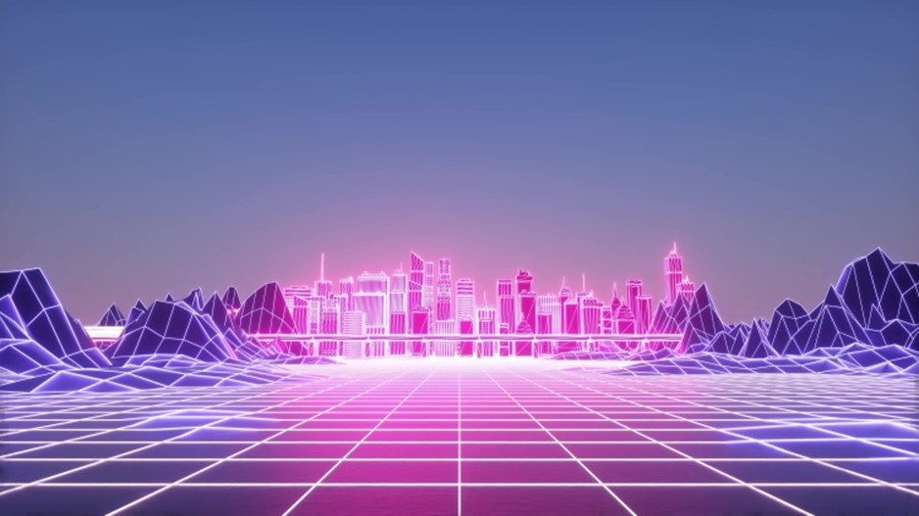
FUTURE OF METAVERSE
It looks like metaverse will be at important point in our lives in future. Therefore many investments are made .Today , while the business world is trying to adapt quickly, it is predicted that many sectors will take place metaverse in the future. From the point of computer vision, extended reality(XR) and augmented reality(ar)technology products will develop, or new products will begin to emerge in the future.

Slide 12
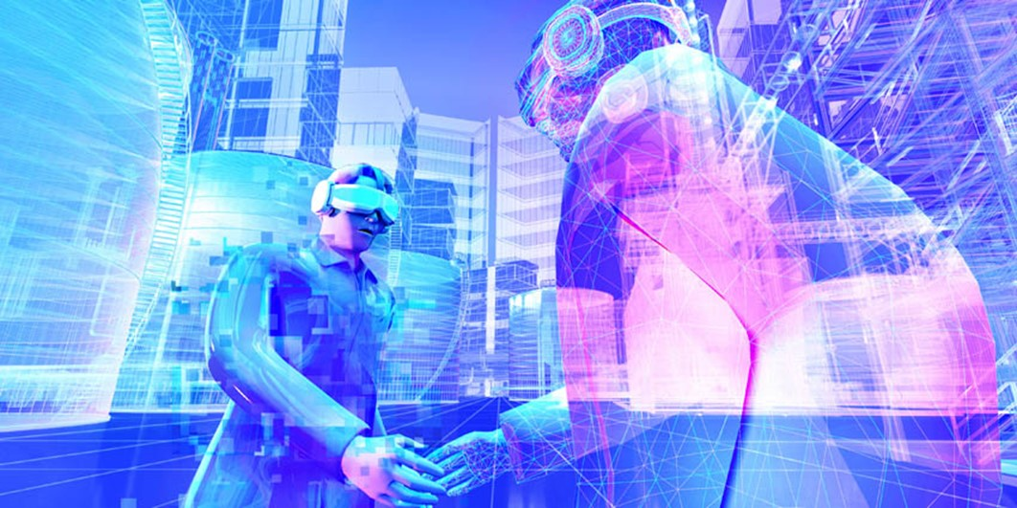
THANK YOU

